Slide 1
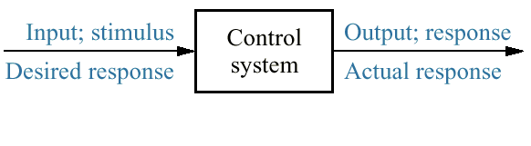
Figure 1.1
Simplified description of a control system

Slide 2
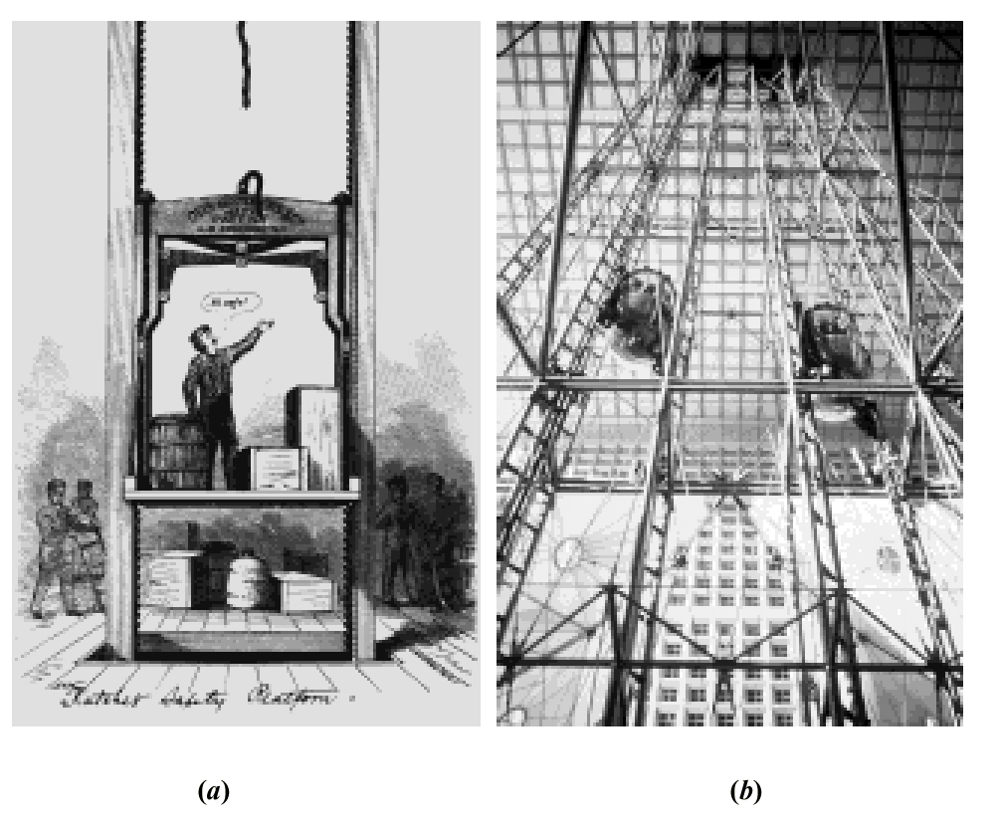
Figure 1.2
Elevators
Photos courtesy of United Technologies Otis Elevator.
a. Early elevators were controlled by hand ropes or an elevator operator. Here, a rope is cut to demonstrate the safety brake, an innovation in early
elevators;
b. Modern Duo-lift elevators make their way up the Grande Arche in Paris, driven by one motor, with each car counterbalancing the other. Today, elevators are fully automatic, using control systems to regulate position and velocity.

Slide 3
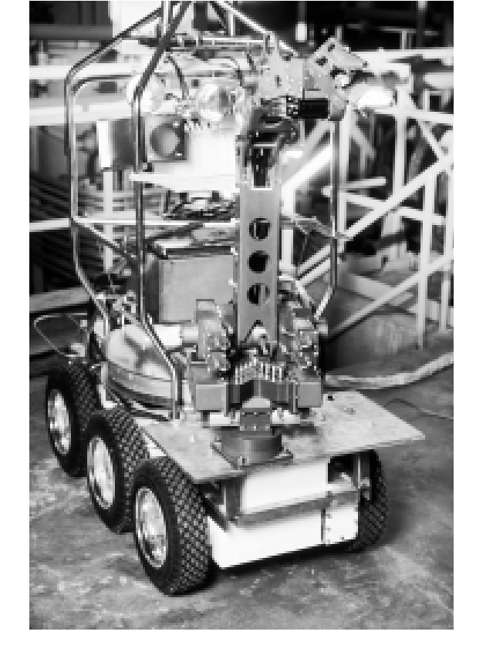
Figure 1.3
Rover was built to work in contaminated areas at Three Mile
Island in Middleton,
PA, where a nuclear accident occurred in
1979. The remote controlled robot’s long arm can be seen at the front of the vehicle.
Photo © Hank Morgan/Rainbow/PNI.

Slide 4
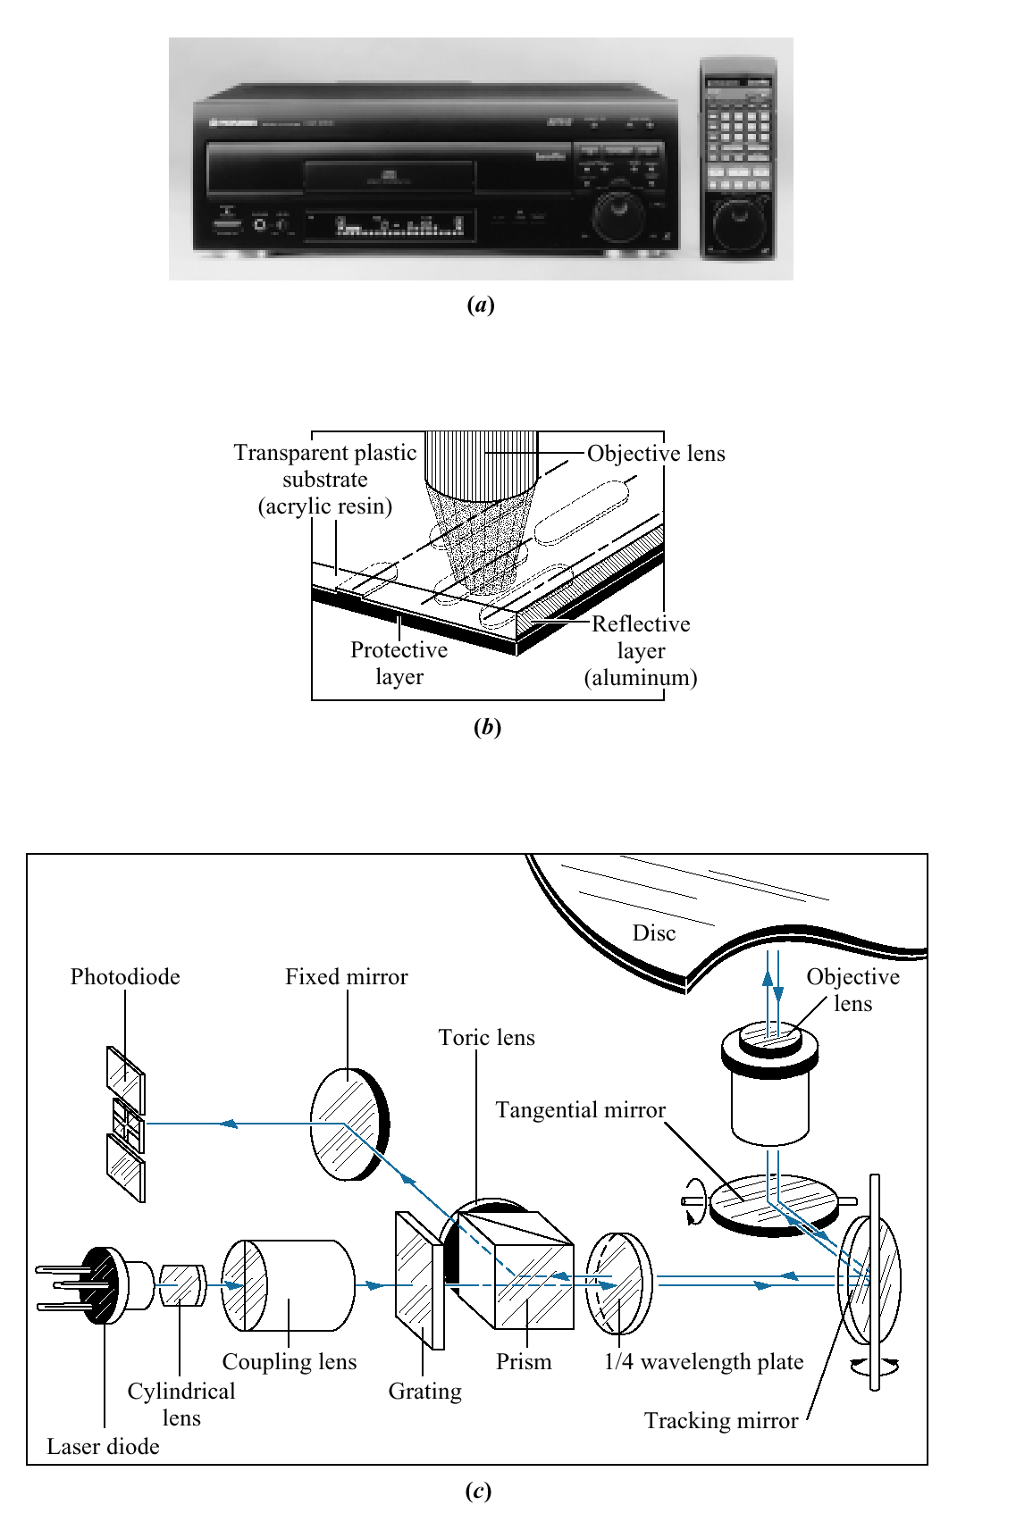
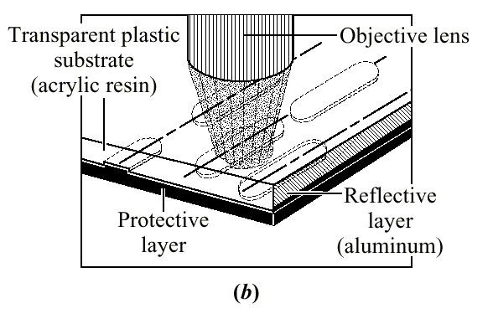
Figure 1.4 a. Video laser disc player; b. objective lens reading pits on a laser disc; c. optical path for playback showing tracking mirror rotated by a control system to keep the laser beam positioned on the pits.
(a)
(b)
(c)
(c) Pioneer Electronics, Inc.

Slide 5
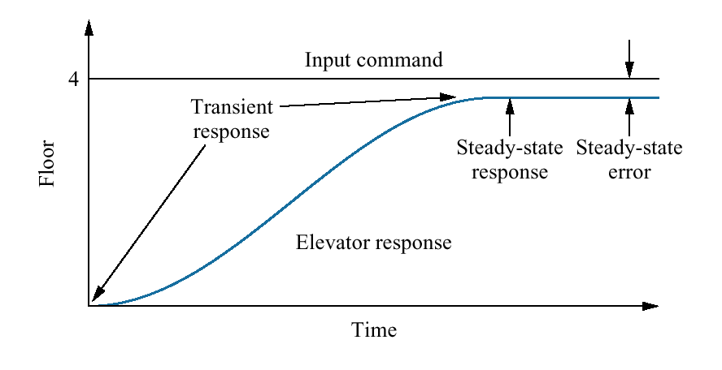
Figure1.5
Elevator input and output

Slide 6
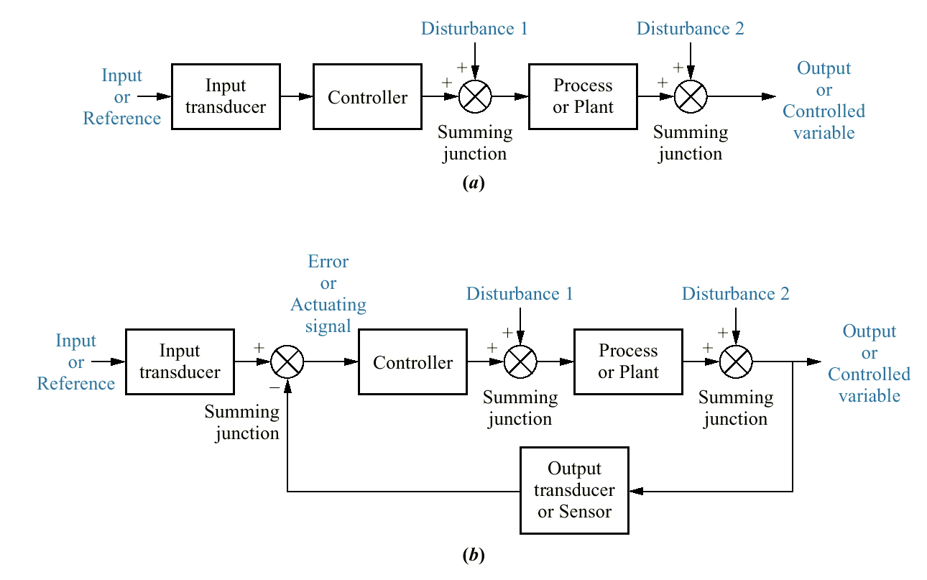
Figure 1.6
Block diagrams of control systems: a. open-loop system; b. closed-loop system

Slide 7
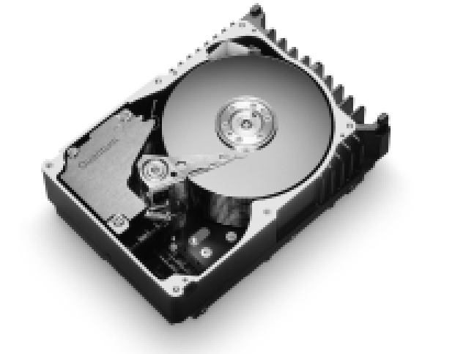
Figure 1.7
Computer hard disk drive, showing disks and read/write head
Courtesy of Quantum Corp.

Slide 8
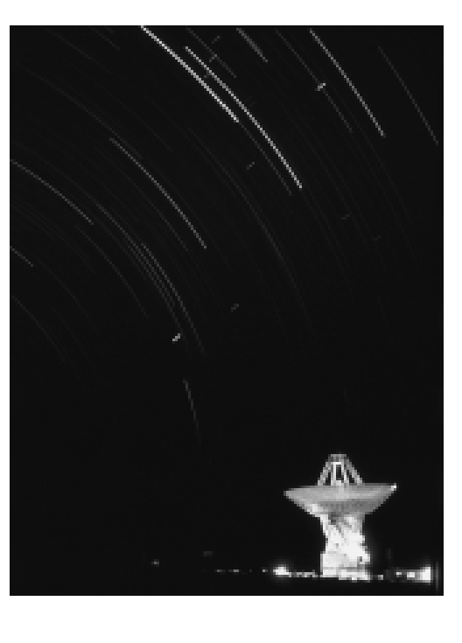
Figure 1.8
The search for extraterrestrial life is being carried out with radio antennas like the one pictured here. A radio antenna is an example of a system with position controls.
© Peter Menzel.

Slide 9
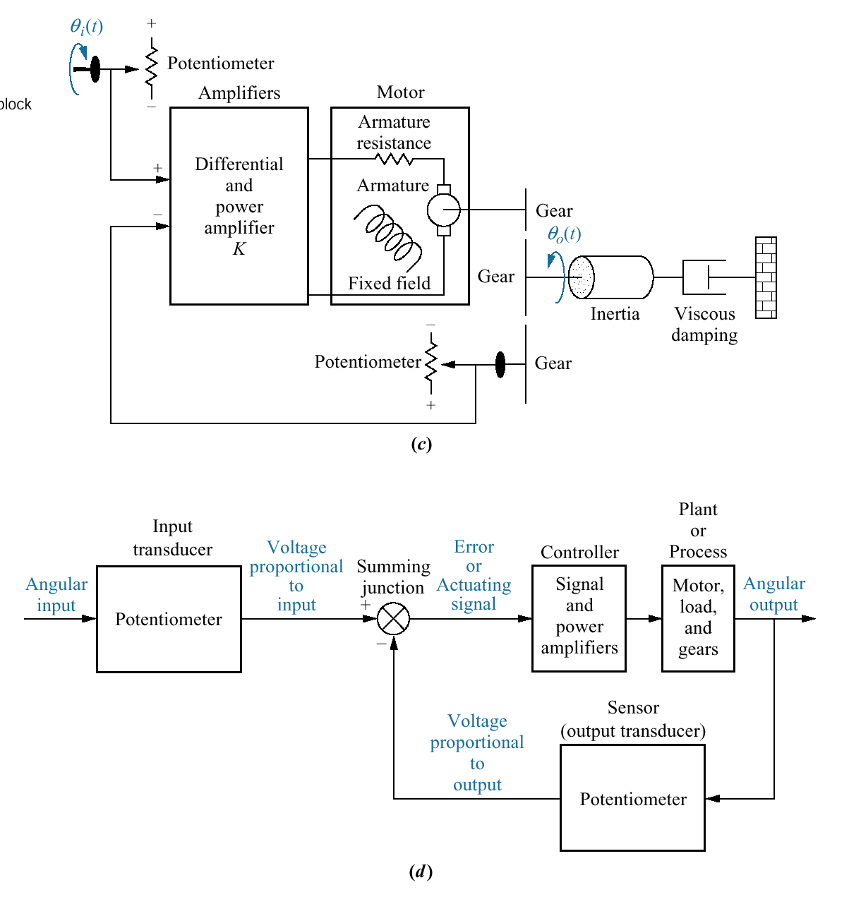
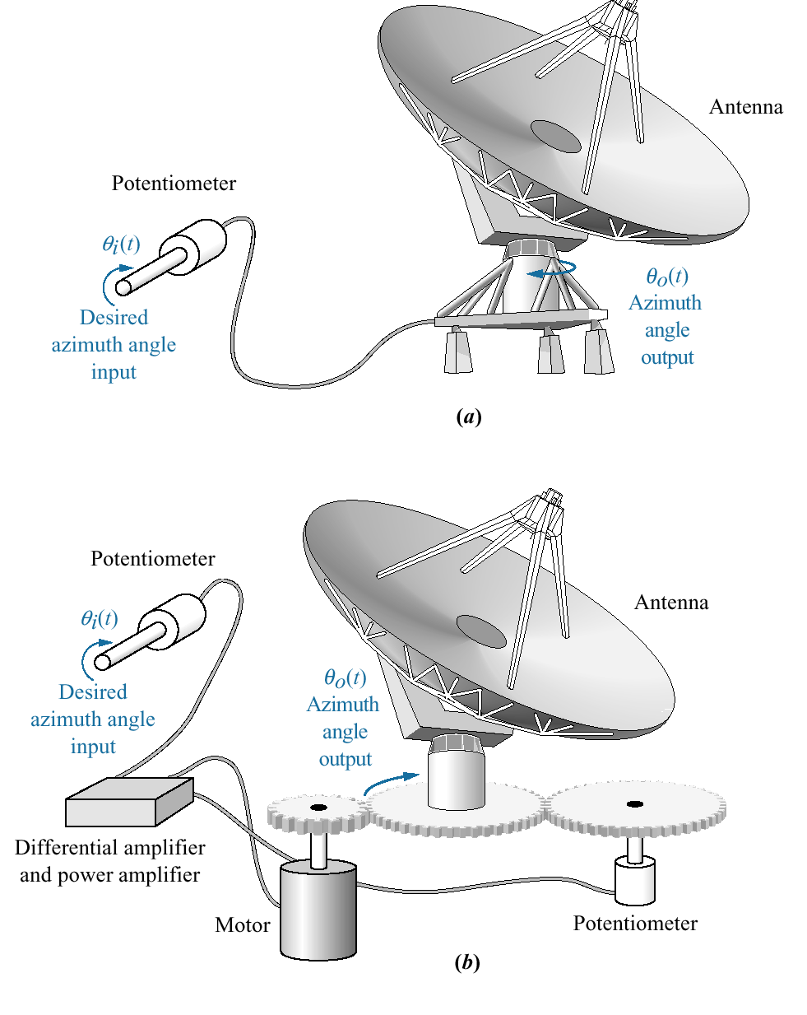
Figure 1.9
Antenna azimuth position control system:
a. system concept;
b. detailed layout;
c. schematic;
d. functional block diagram

Slide 10
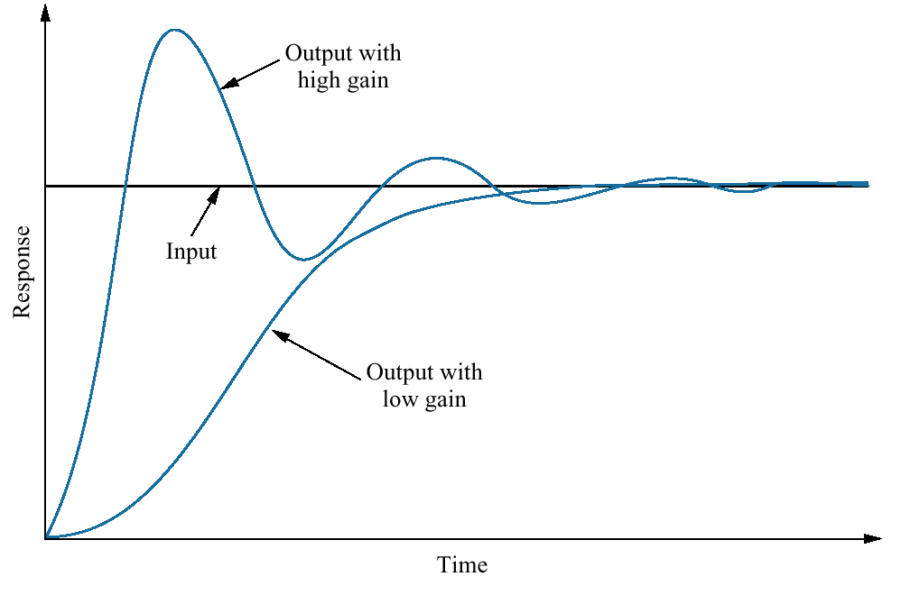
Figure 1.10
Response of a position control system showing effect of high and low controller gain on the output response

Slide 11
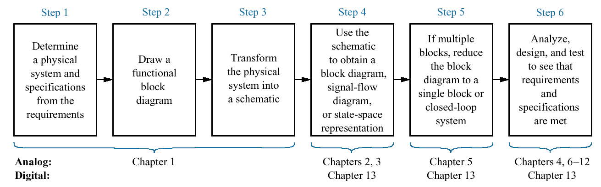
Figure 1.11
The control system design process

Slide 12
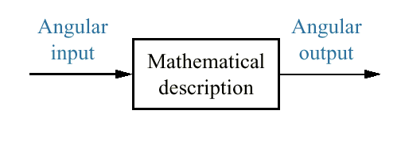
Figure 1.12
Equivalent block diagram for the antenna azimuth position control system

Slide 13
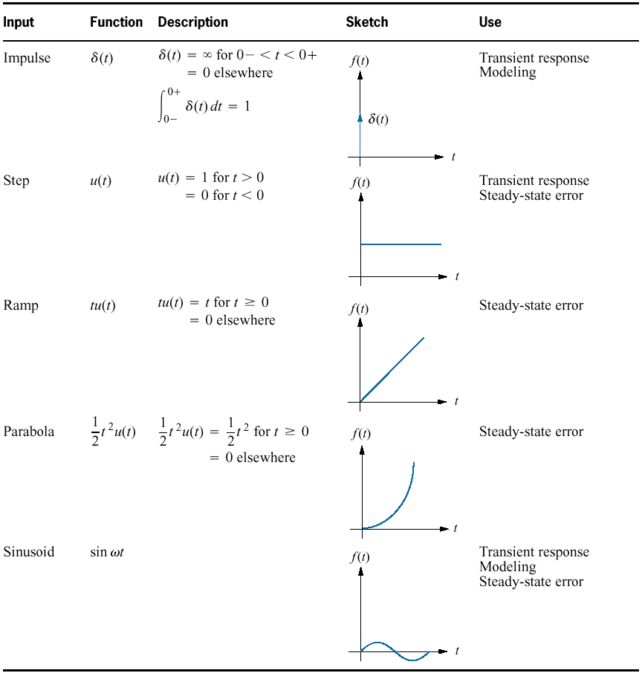
Table 1.1
Test waveforms used in control systems

Slide 14
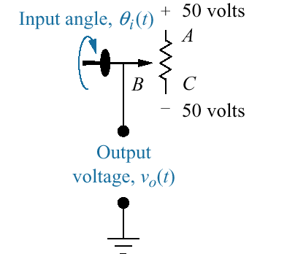
Figure P1.1
Potentiometer

Slide 15
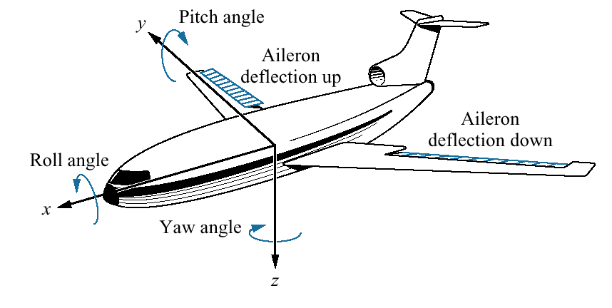
Figure P1.2
Aircraft attitude defined

Slide 16
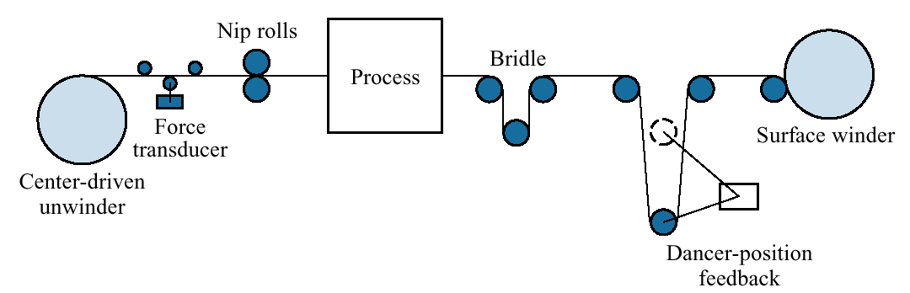
Figure P1.3
Winder
© J. Ayers, 1988.

Slide 17
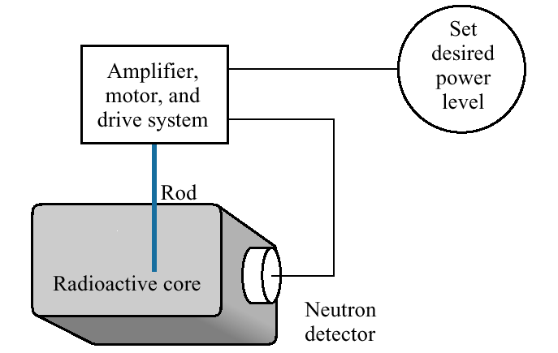
Figure P1.4
Control of a nuclear reactor

Slide 18
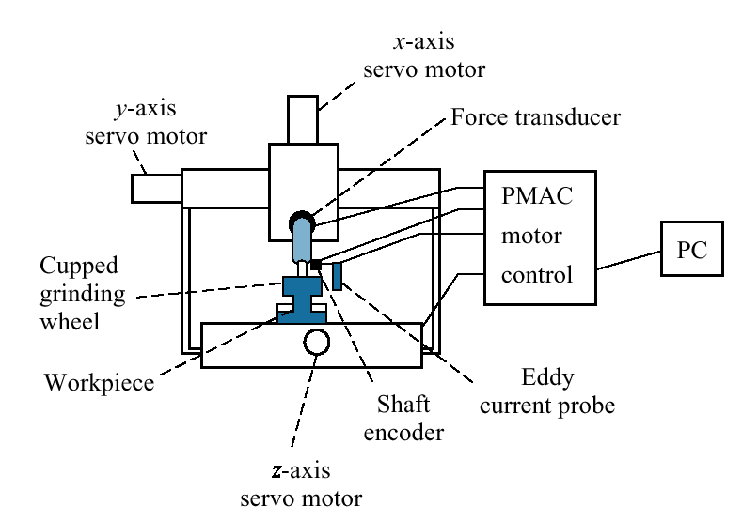
Figure P1.5
Grinder system
© 1997, ASME.

Slide 19
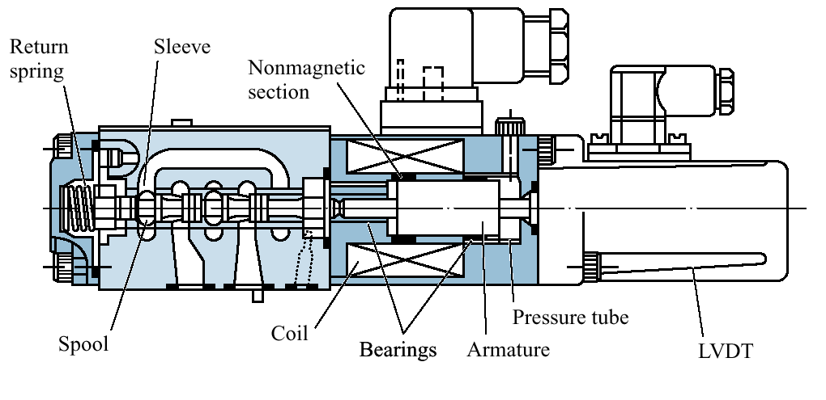
Figure P1.6
High-speed proportional solenoid valve
© 1996, ASME.

Slide 20
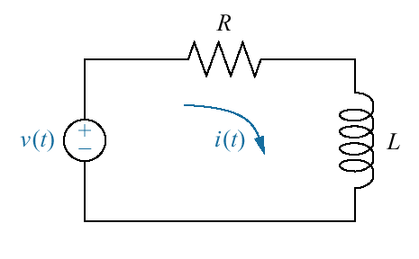
Figure P1.7
RL network

Slide 21
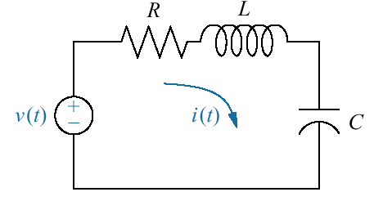
Figure P1.8
RLC network

Slide 22
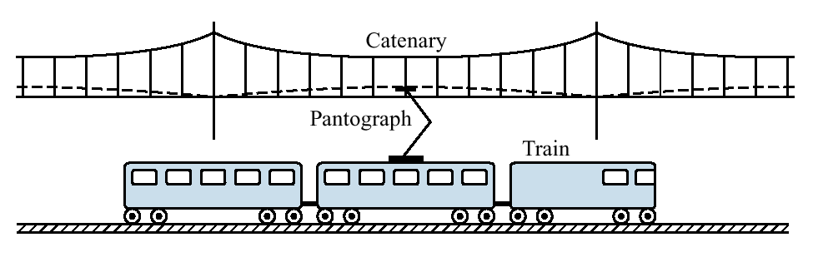
Figure P1.9
High-speed rail system showing pantograph and catenary
© 1997, ASME.

